Slide 1

Topic: Fractions
EQ: How do we use arrays to add and subtract fractions?
We’ll need graph paper for this lesson!

Slide 2

24
7
30
Topic: Fractions
Date
EQ: How do we use arrays to add and subtract fractions?
Let’s get thinking!
The family bought some pizzas. I ate $\frac{4}{8}$ of the pepperoni pizza and $\frac{3}{8}$ of the ham and pineapple pizza. How much pizza did I eat?
Is it less than, more than or equal to one? Why?
Discuss it with your shoulder partner & be prepared to share.

Slide 3
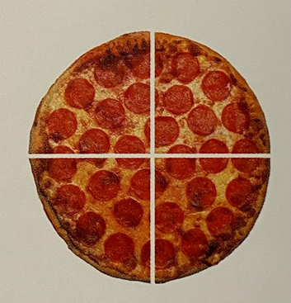

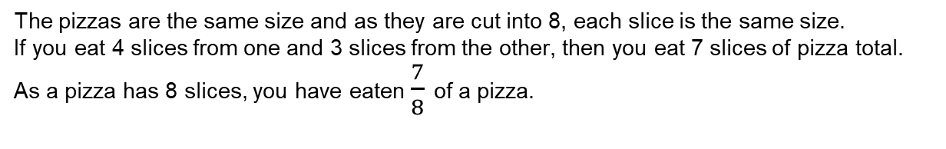
24
7
30
Topic: Fractions
Date
EQ: How do we use arrays to add and subtract fractions?
The pizzas are the same size and as they are cut into 8, each slice is the same size.
If you eat 4 slices from one and 3 slices from the other, then you eat 7 slices of pizza total.
As a pizza has 8 slices, you have eaten $\frac{7}{8}$ of a pizza.
Notes:
Repeat questioning using different amounts of slices

Slide 4

24
7
30
Fractions
Date
EQ – How do we use arrays to add and subtract fractions?
Adding With Same Denominator
$$\frac{1}{7}+\frac{4}{7}$$

Slide 5
24
7
30
Fractions
Date
EQ – How do we use arrays to add and subtract fractions?
Adding With Same Denominator
$$\frac{1}{7}+\frac{4}{7}$$

Slide 6

24
7
30
Fractions
Date
EQ – How do we use arrays to add and subtract fractions?
Adding With Same Denominator
$$\frac{1}{7}+\frac{4}{7}$$

Slide 7

24
7
30
Fractions
Date
EQ – How do we use arrays to add and subtract fractions?
Adding With Same Denominator
$$\frac{1}{7}+\frac{4}{7}=\frac{5}{7}$$

Slide 8
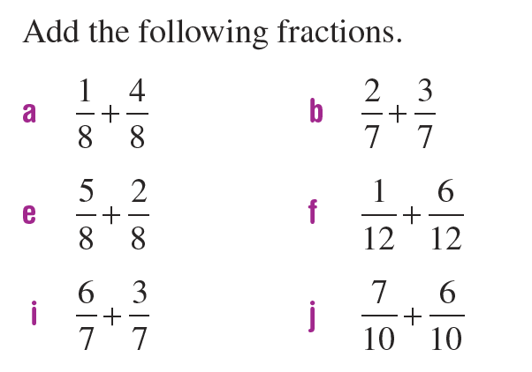
Practice

Slide 9

24
7
30
Fractions
Date
EQ – How do we use arrays to add and subtract fractions?
Method 1
Subtracting With Same Denominator
$$\frac{6}{7}−\frac{2}{7}$$

Slide 10
24
7
30
Add and Subtract Fractions: Same Denominator
Date
EQ – How do we use arrays to add and subtract fractions?
Method 1
Subtracting With Same Denominator
$$\frac{6}{7}−\frac{2}{7}$$

Slide 11
24
7
30
Fractions
Date
EQ – How do we use arrays to add and subtract fractions?
Method 1
Subtracting With Same Denominator
$$\frac{6}{7}−\frac{2}{7}$$

Slide 12

24
7
30
Fractions
Date
EQ – How do we use arrays to add and subtract fractions?
Method 1
Subtracting With Same Denominator
$$\frac{6}{7}−\frac{2}{7}=\frac{4}{7}$$

Slide 13
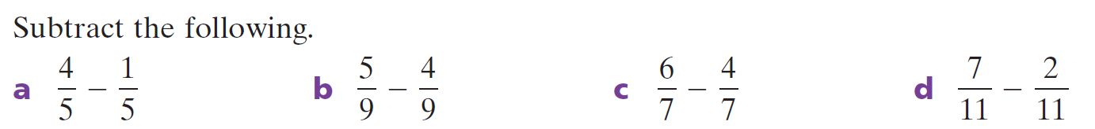

Slide 14


Slide 15
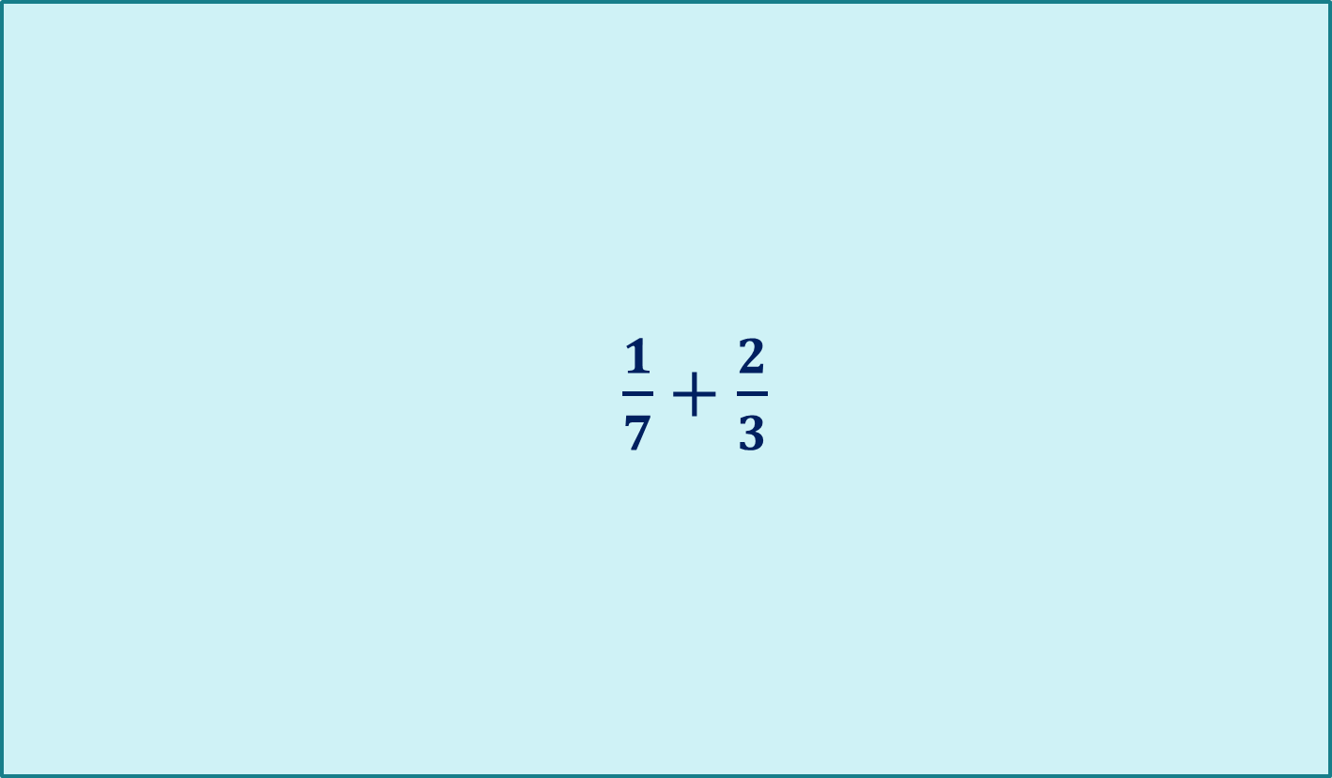
24
7
30
Fractions
Date
$\frac{1}{7}+\frac{2}{3}$
EQ: How are arrays used to add and subtract fractions?
How can we add these fractions using arrays?
What methods do you know to add these?
Discuss with your shoulder partner and be prepared to share
Different denominators

Slide 16
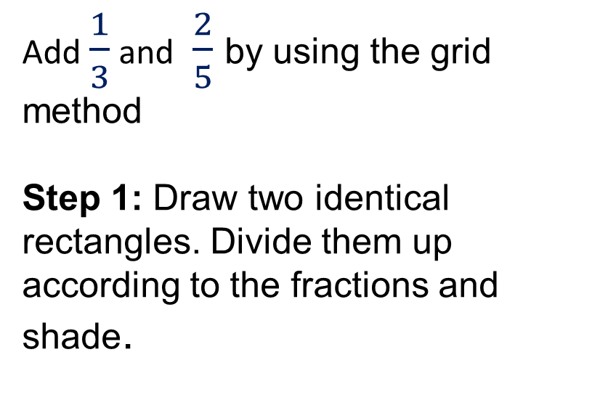
24
7
30
Fractions
Date
EQ – How do we use arrays to add and subtract fractions?
Add $\frac{1}{3}$ and $\frac{2}{5}$ by using the grid method
Step 1: Draw two identical rectangles. Divide them up according to the fractions and shade.
Adding with different denominator

Slide 17
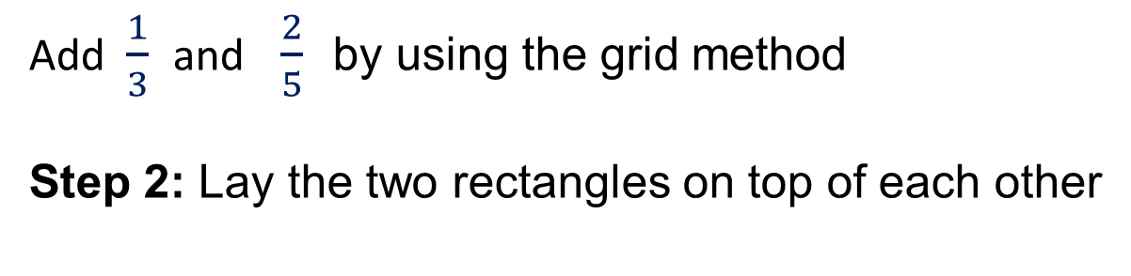
24
7
30
Fractions
Date
EQ – How do we use arrays to add and subtract fractions?
Add $\frac{1}{3}$ and $\frac{2}{5}$ by using the grid method
Step 2: Lay the two rectangles on top of each other
Adding with different denominator

Slide 18
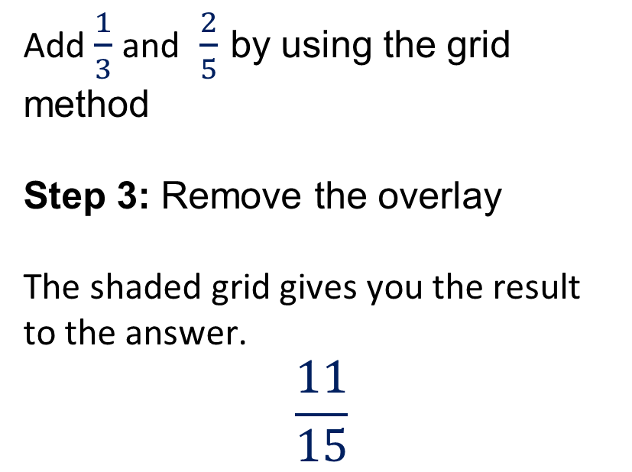
24
7
30
Fractions
Date
EQ – How are arrays used to add and subtract fractions?
Add $\frac{1}{3}$ and $\frac{2}{5}$ by using the grid method
Step 3: Remove the overlay
The shaded grid gives you the result to the answer.
$$\frac{11}{15}$$
Adding with different denominators

Slide 19
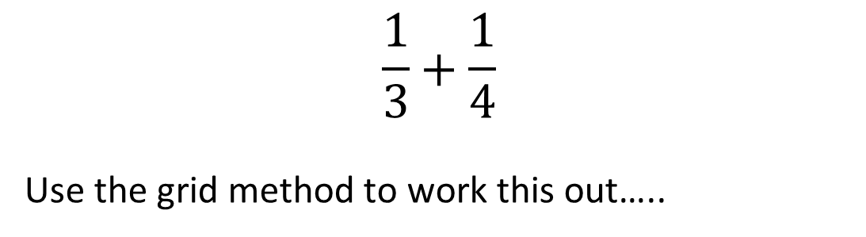
Practice
$$\frac{1}{3}+\frac{1}{4}$$
Use the grid method to work this out…..

Slide 21
24
7
30
Topic: Fractions
Date
EQ: How do we use arrays to add and subtract fractions?
Write your summary in your interactive notebook.
Discuss with your shoulder partner/table.
Be prepared to share ☺
.
.

